Slide 1
Identifying New Business Opportunities In South Dublin City, Ireland
Alexander Sloane, May 2020

Slide 2
Introduction
Ireland
$382.5 Billion GDP
6th Globally in GDP-per-Capita
8.2% GDP Growth in 2018-2019
Dublin
Capital City of Ireland
28% of Irish Population
1.3% Population Growth in 2019
$115 Billion GDP
$86,000 GDP-per-Capita
1.1% GDP Growth in 2018-2019
Dún Laoghaire–Rathdown
Wealthy and rapidly-growing region in south of Greater Dublin Area
Business Problem
Analyse DLR Region
Identify Business Opportunities for Potential Investors

Slide 3
Data Description
Data Sources
Population Statistics from Central Statistics Office (CSO)
Published in 2016, after last census in Ireland
Available in PDF format online
Table showing Population Size and Growth for each Electoral District in DLR Region
Relevant Features in Data
Name of Electoral District
2016 Population of Electoral District
2011 to 2016 Population Growth of Electoral District
Number of venues in Electoral District in each business category
Percentage of total venues claimed by each category

Slide 4
Methodology
Import Dublin Populations File as DataFrame
Wrangle Data into more Usable Format
Get Coordinates for each Electoral District
Create Map of DLR Region
Define Foursquare Data and Radius of Each ELectoral District
Create Function to Get Foursquare Data for each District
Use Function for each District
Get Frequency of Venue Categories
Sort Venues in Descending Order for Districts
Add Population Data and Rank by Growth
Display Districts with Maximum Population Growth and Venue Types
Remake Map with Top 10 Districts for Population Growth

Slide 5
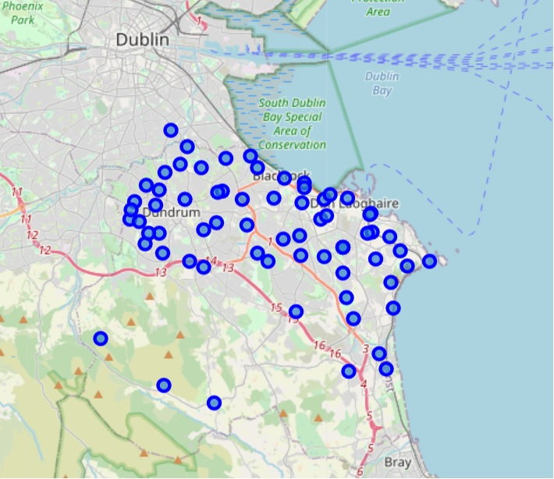
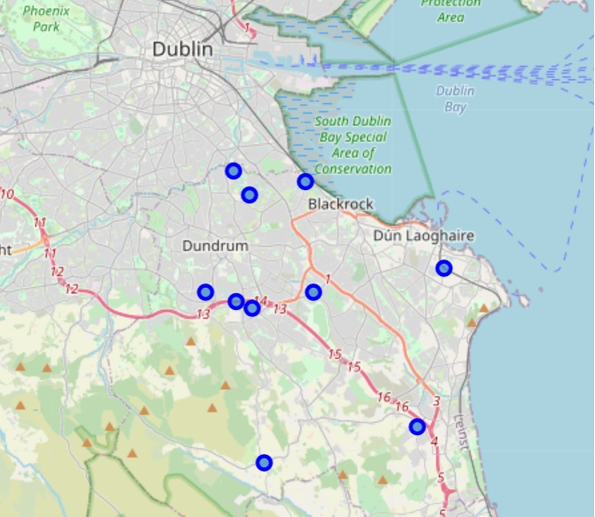
Results
Figure 1 - Districts of DLR Figure 2 - Top 10 Fastest-Growing Districts

Slide 6
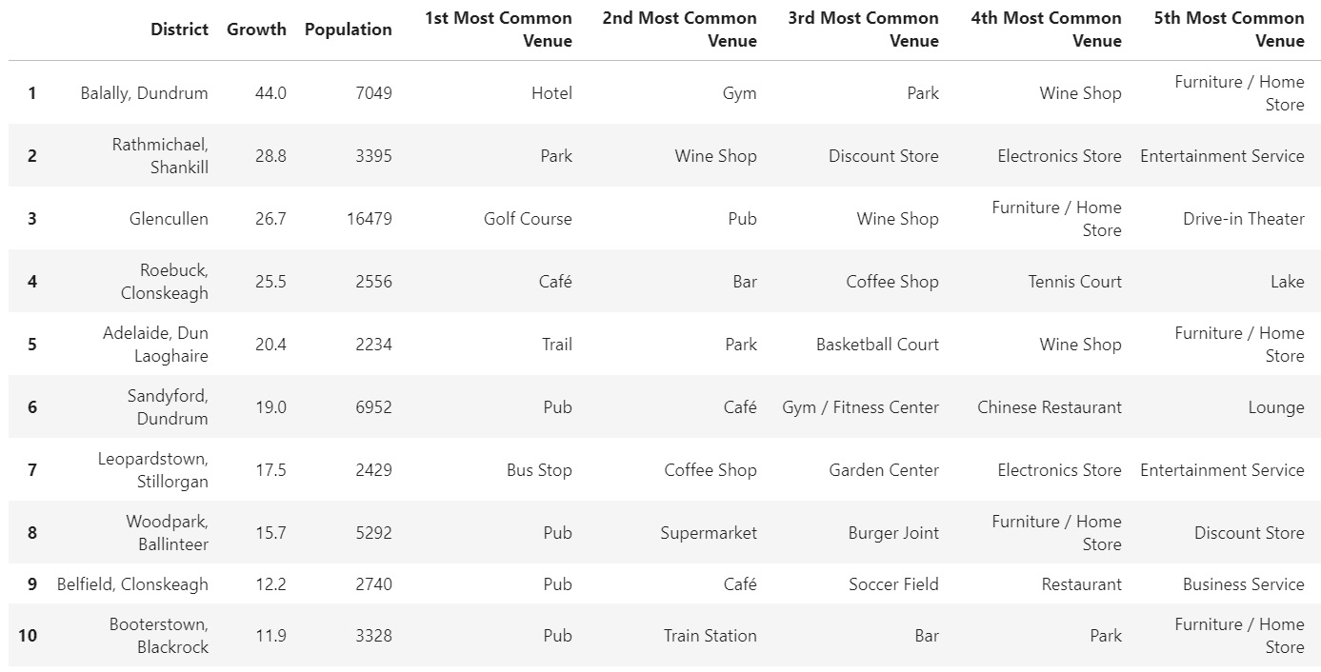
Figure 3 - Most Common Venue Types in Top 10 Fastest-Growing Districts
Figure 1 - Districts of DLR Figure 2 - Top 10 Fastest-Growing Districts

Slide 7
Discussion
Business Categories
345 Business Categories Identified (Five for each of sixty-nine Districts)
73% were in retail, hospitality, and entertainment sectors
Most common types were:
Food/Drink Shop or Supermarket (23%)
Pub (14%)
Restaurant (9%, counting all restaurant types)
Recreational Area (6%, counting all Parks, Gyms, Pools, Cinemas, Sports Arenas, and Hiking Trails)
Business Locations
Five of Ten Fastest-Growing Districts were in Light-Urban Areas
Four of Ten were in Heavy-Urban Area
One of Ten in Mountains
Personal Relaxation Businesses did well in Light-Urban Areas
Sports Venues did well in Heavy-Urban Areas
Venues requiring space did well in Mountains

Slide 8
Conclusions
Food and Drink Sector found to show huge economic potential in DLR Region
Pubs, Restaurants, Food Stores, Cafes all viable business opportunities
Type of Business that’s likely to succeed also depends on Geographic Location

